Slide 1
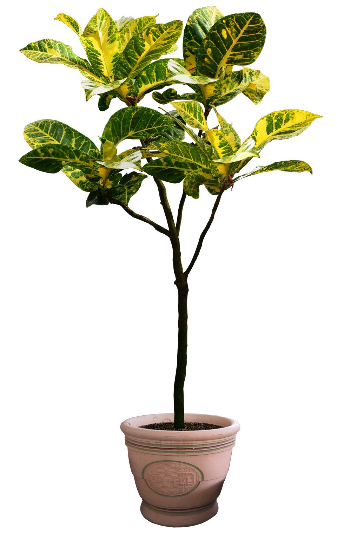



Cant(a)eiro A project for music creation with plants Filipe Lopes Rui Ferreira Mafalda Fonseca
Notes:
My name is Filipe Lopes.
I’ll be talking about Cantaeiro.
It is a mix of the word sing with small garden. In portuguese it sounds nice… I hope you believe that.
Well,cantaeiro is a project about creating music with plants based on digital technologies.

Slide 2
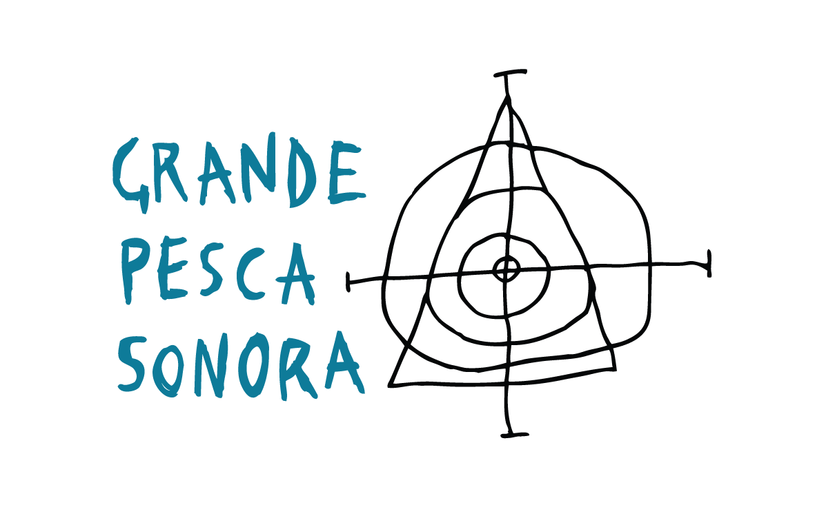
OJM
OJM is a jazz orchestra from Matosinhos. I am the
head of the education department.
Grand Sounding Fishery
It is our main project and it runs during the school year. Its consists of workshops, concerts and research. We work with schools and institutions mainly from Matosinhos.
music with plants
plants with music
each Grand Sounding Fishery has a theme. This year the theme is Music with plants, plants with Music
Notes:
A little bit of myself.
I am a composer, teacher but I also am coordinating the educational services of the Matosinhos Jazz Orchestra.
Our main educative project is called Grand Sounding Fishery, it runs from October till June and consists of a series of workshops, performances and research and we work with generic schools, music schools and institutions. The work we do is not only about music but mixes theatre, video, photography, body, movement, poetry…
Well, each GSF has a theme which is sort of abstract but inspirational to some extent. While music is the central element of each GSF, music is not the starting point but instead the meeting point, in other words, we always start from scratch and let all the arts/inputs come together to form the compositions and performances.
This year our theme is music with plants, plants with music and we have been creating, composing and performing.

Slide 3
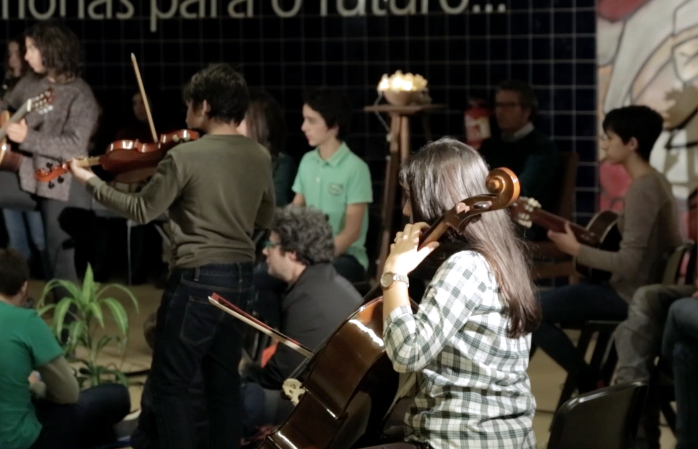
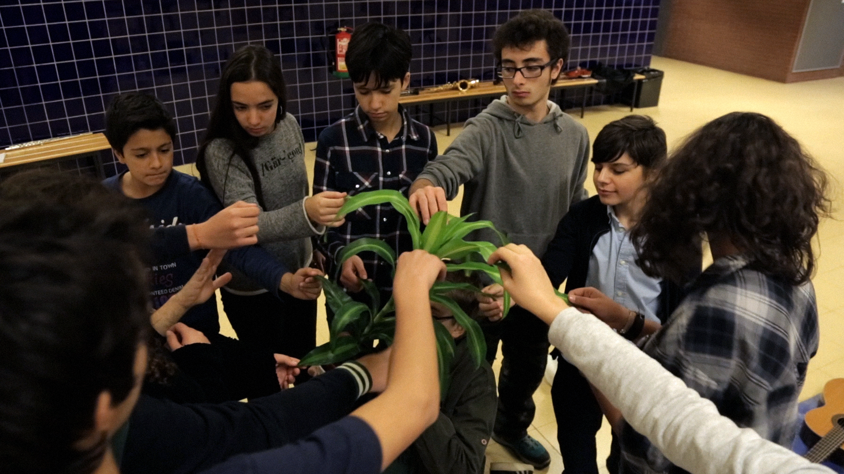
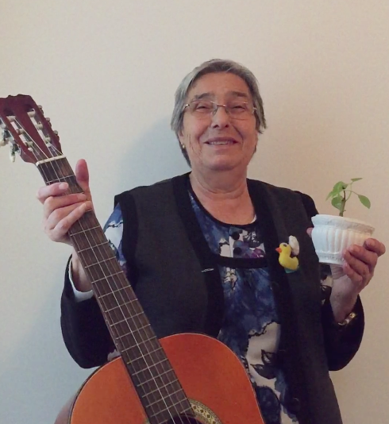
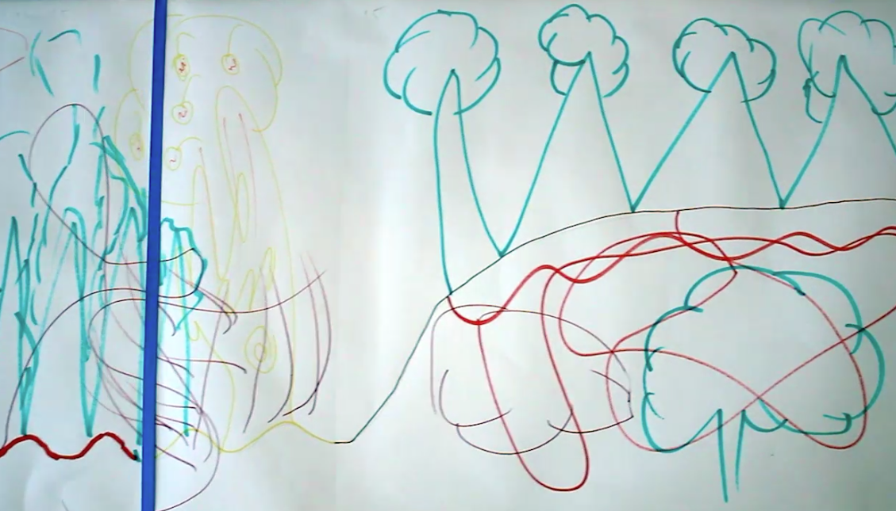
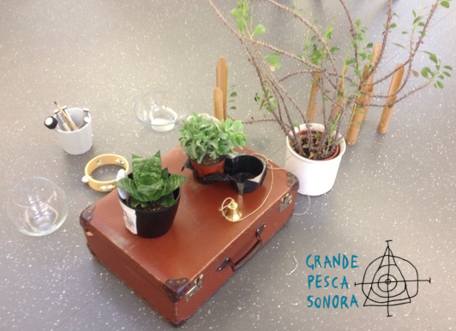
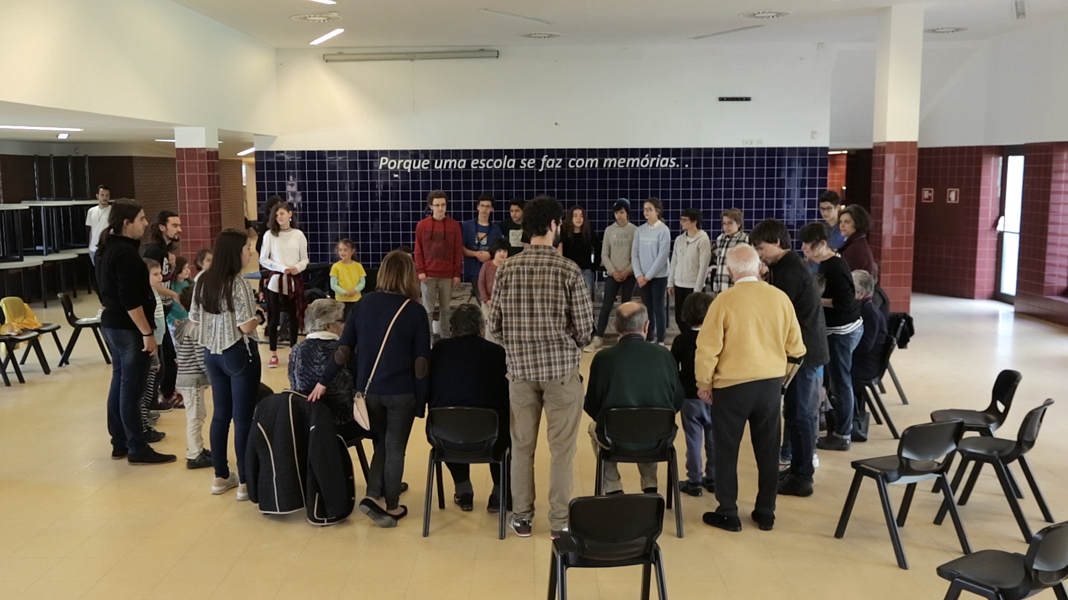
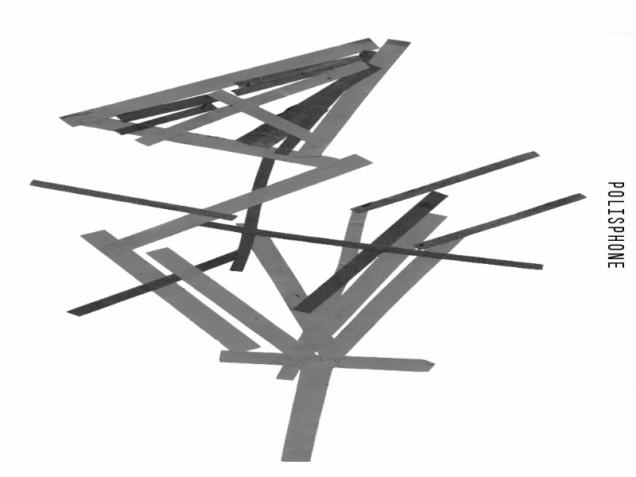
Notes:
The most important idea is that I believe the plant does not make music but instead can be an active part in music composition and music performance. So Cant(a)eiro, has been being developed based to promote these premisses we have been talking.
Anyways, to me, it really does not matter the truth about some ideas of plants. I just think it is lovely to accept plants are sentiment and intelligente and, thus, that they can make music together with us. To nurture a relation with plants in an artistica fashion but also contribute to develop affectivity for the plants.

Slide 4

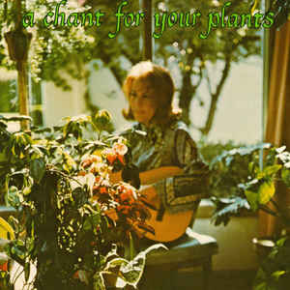
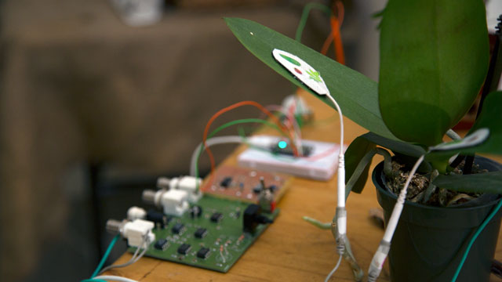

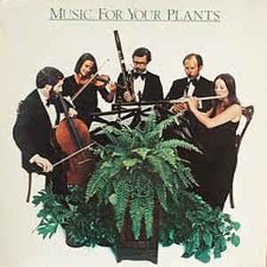
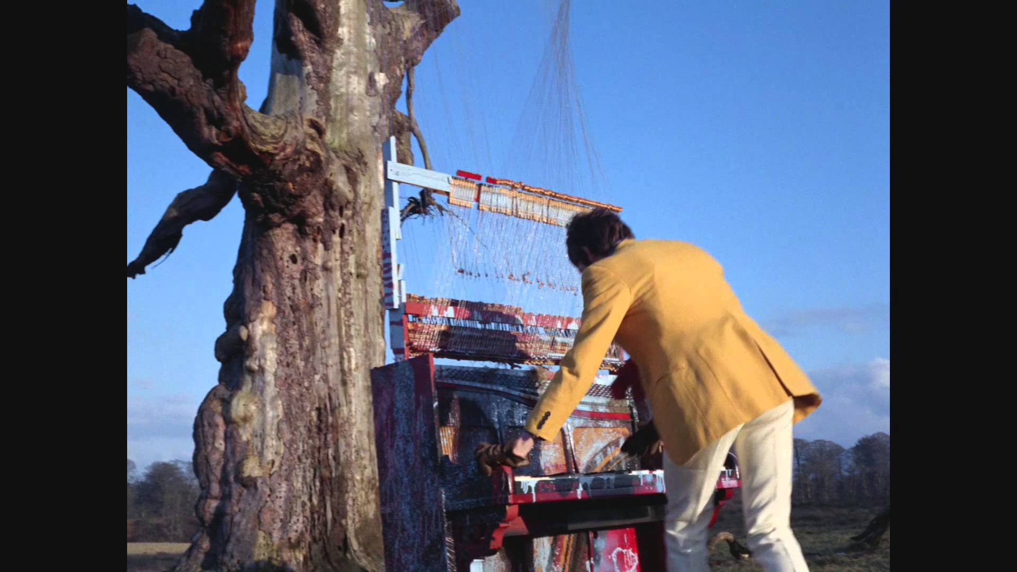
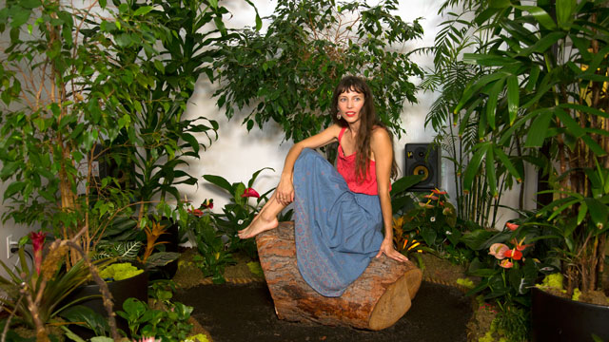
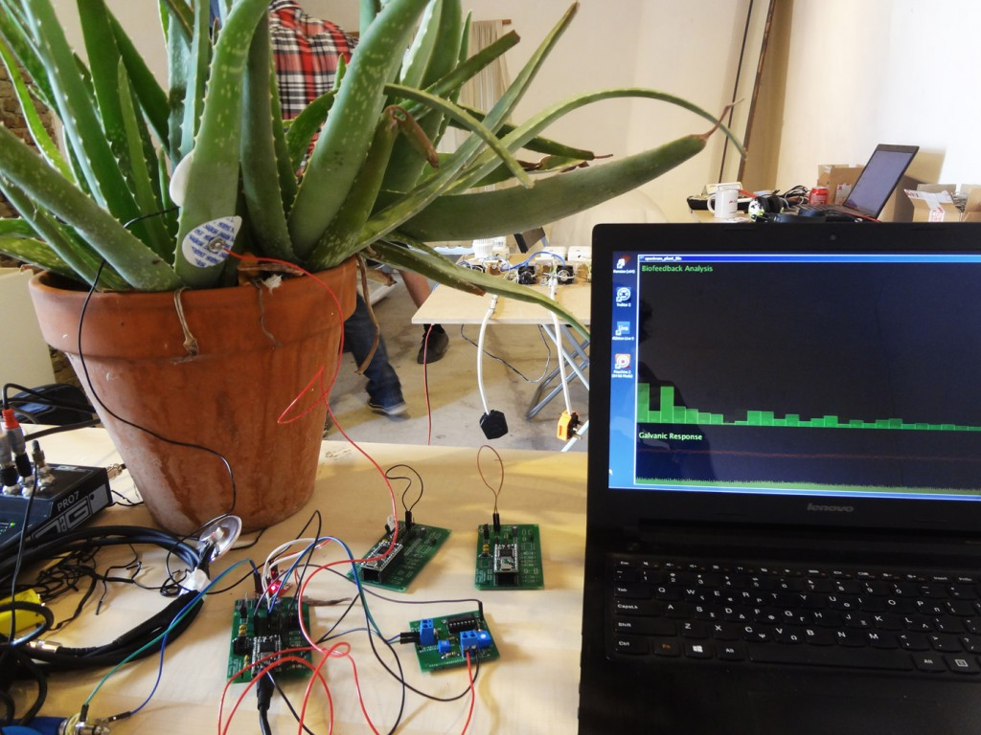
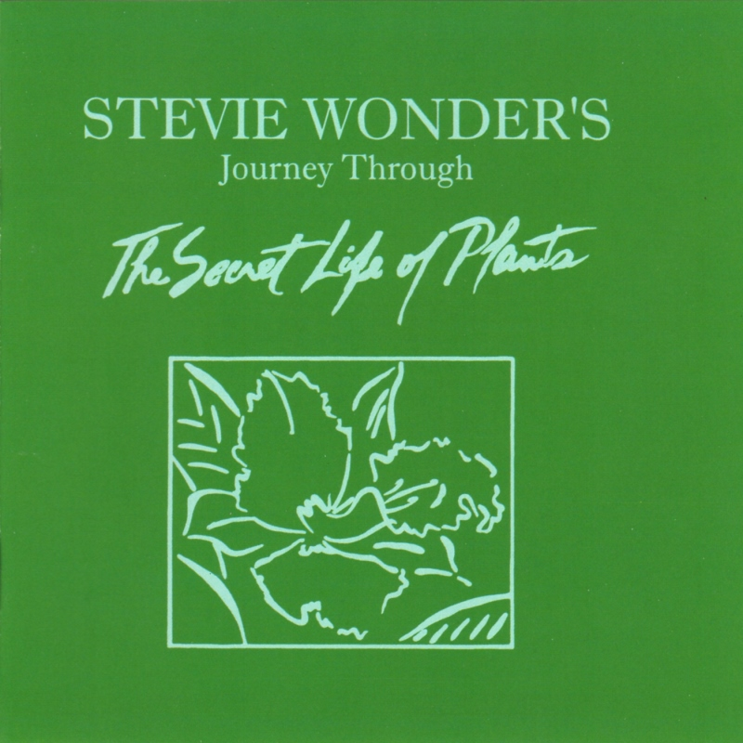
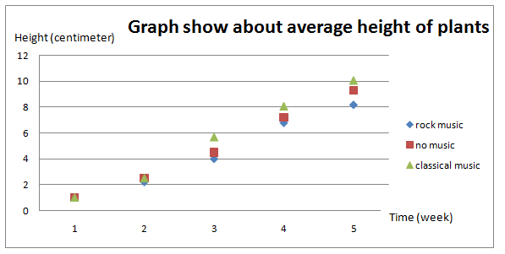
plants
music
sound
the idea to gather plants and music making has been present for a long time and has been approached in many ways.
We believe that there are two main trends:
1 – plants as listeners/recipients
2 – plants as performers/producers
Notes:
The idea to combine music and plants is not new at all. It goes from Vivalidi to the Beatles (strawberry Fields), Tachkovsky (valsa das flores) and many others.
Since the 20th century there has been investigation and experiments made in an attempt to understand if plants respond to specific types of music, particularly their growth.
And people other approaches such as the one by, like Milecce X, which collects electrical activity from plants to create music.
In fact, there are a lot of activities made that relate music and plants.
We believe that there are two main trends:
1 – plants as listeners/recipients
2 – plants as performers/producers

Slide 5
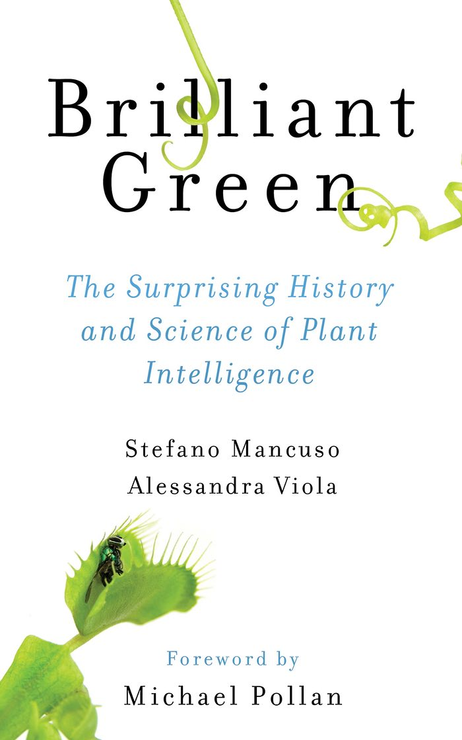
Notes:
This book was really inspiring and it gathers in the same place lots of ideas of was collecting in different places. Importantly, the ideas discusses on this book are presented with proper scientific proofs, not just beliefs.

Slide 6
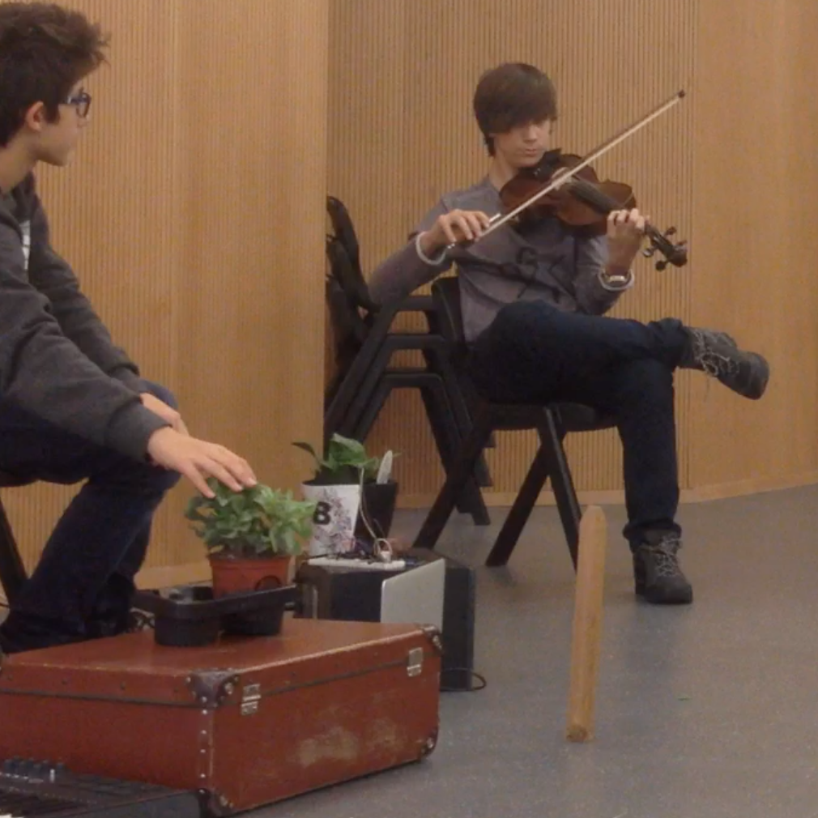
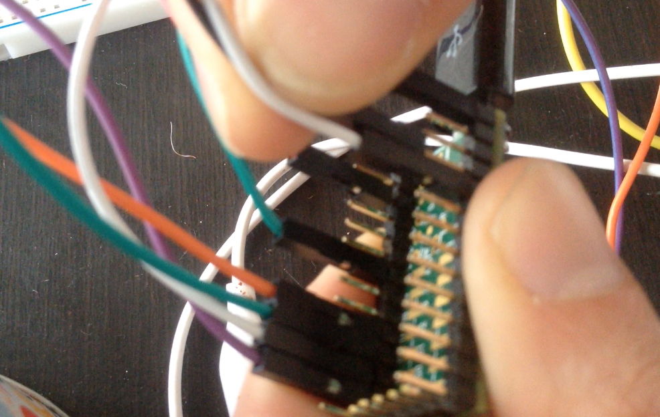
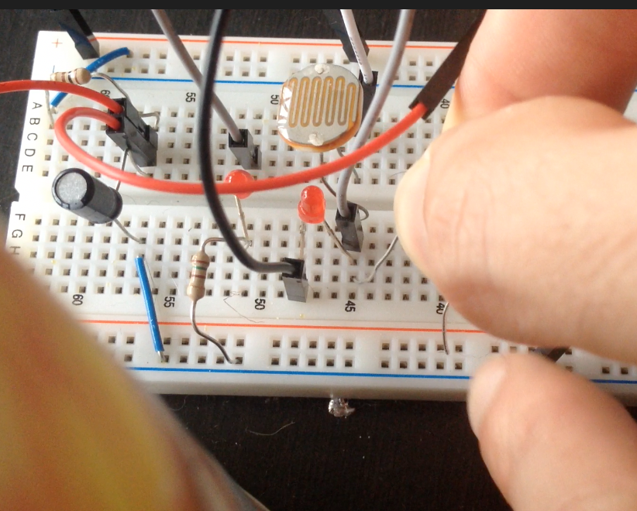
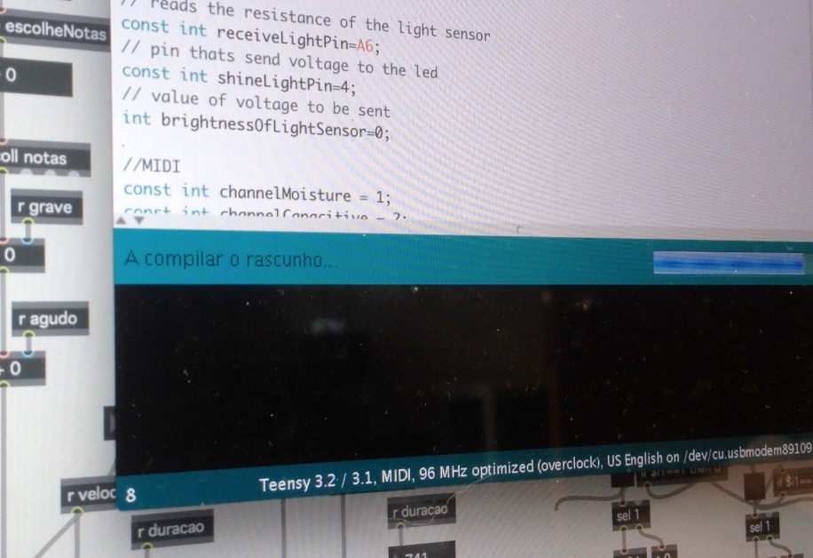
music with plants
plants with music
01
compose and perform music with plants
02
implement digital technologies to amplify the “voice” of a plant
Notes:
Well, to approach the idea of composing and discovering ways to music with plants, I divided the approach in two branches:
The first one is related to generic artistic creation using and with plants. The second one targeted to use digital technologies to amplify the voice of a plant.
The first one is really important to me because, generally speaking and I am not going very deep on this, but technology is not a guarantee of good music, inclusion, musical education. It might be elusive about that, however, the problem is not the technology itself but instead how we work with it, how we take things for granted. So I believe technologies are wonderful and open new ways to work music, to make musical practice more inclusive to people that do not study music, etc and all.
Overall, it seemed important to develop many approaches to work with plants in order to develop meaningful technologies and, basically, to have a broader sense of plants in our work.
Basically, it was important to spend many sessions experimenting making music with plants and envolving the children to come up with ideas. I can talk to you about that afterwards.

Slide 7
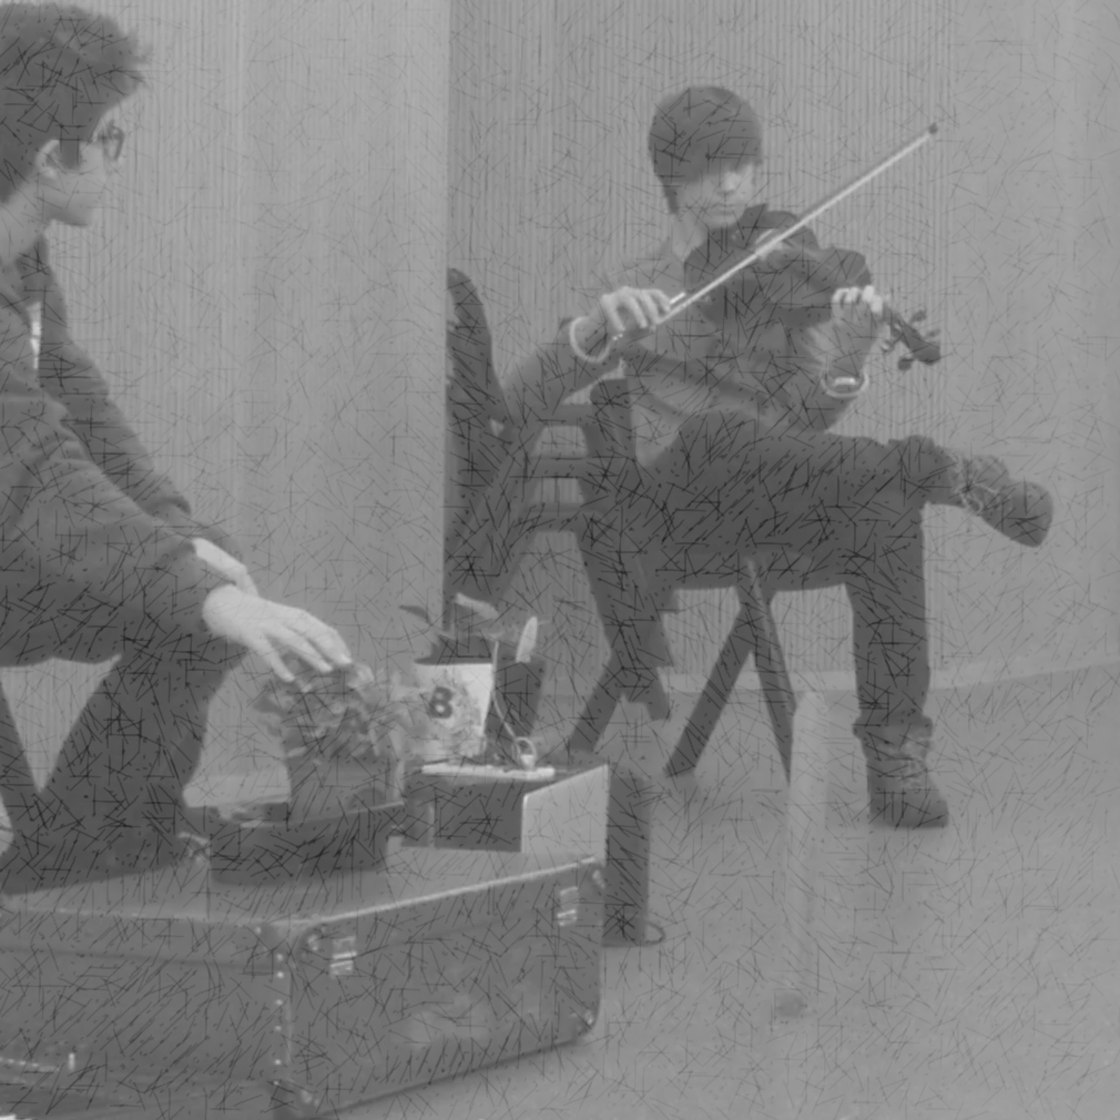
music with plants
plants with music
01
compose and perform music with plants
Cant(a)eiro
Notes:
Cant(a)eiro is specifically concern with digital technologies and music making, however, in close relationship with the finding we get from the project itself.

Slide 8
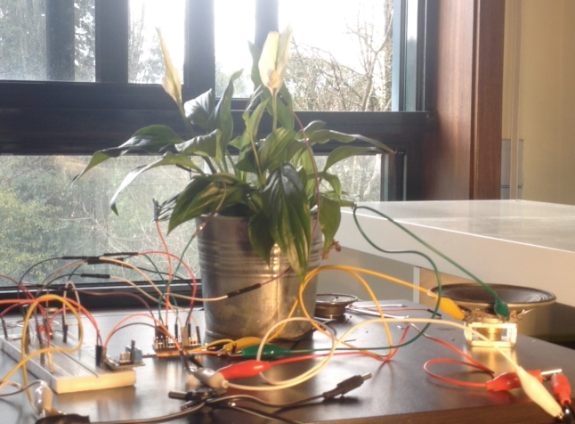
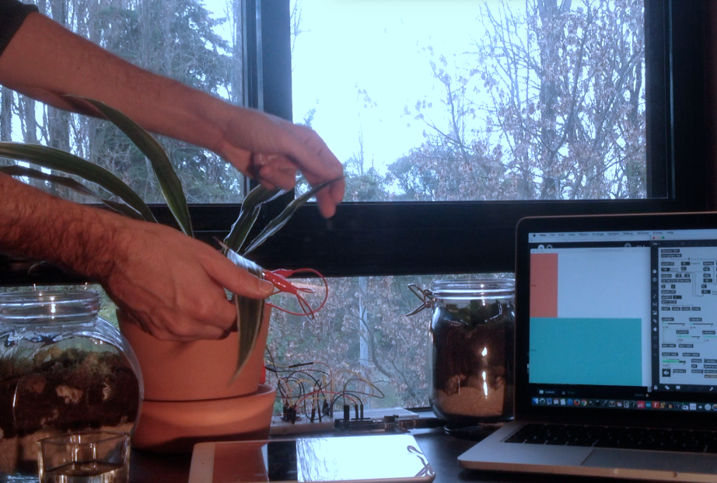
Goals
1- To develop an affordable hybrid system based on plants and electronics to create and perform music within school environments
2- To nurture a fruitful relationship with plants and nature
3- To promote the interest for electronics and computer programming
Notes:
1- To develop an affordable hybrid system based on plants and electronics to create and perform music.
2- To teach basic computer programming skills using an organic system
3- To nurture a fruitful relationship with plants and nature
(show you)

Slide 9
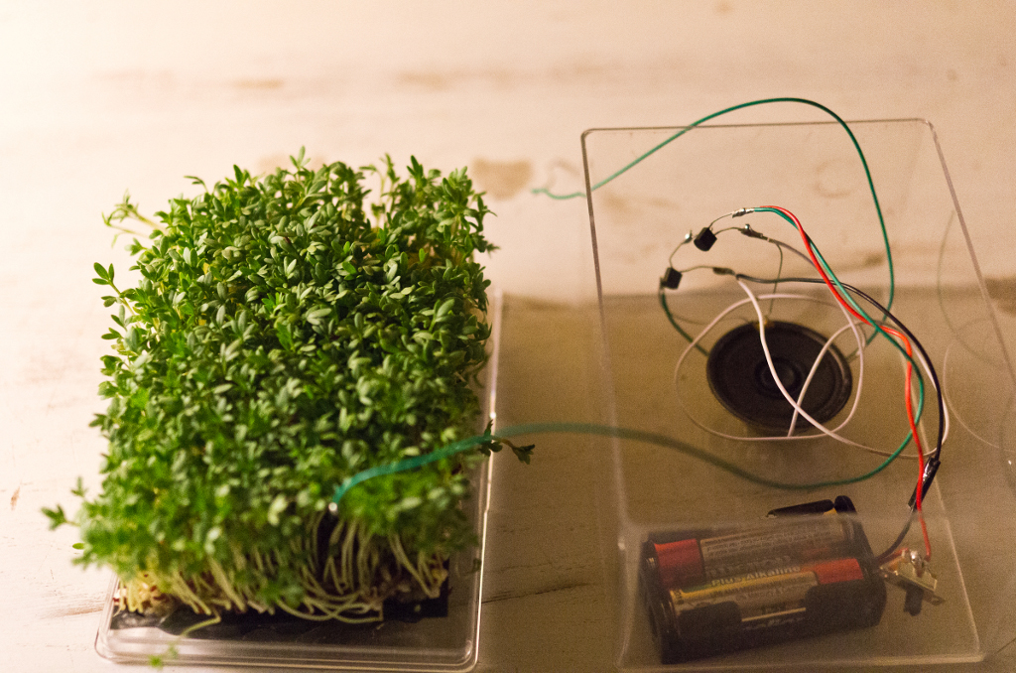
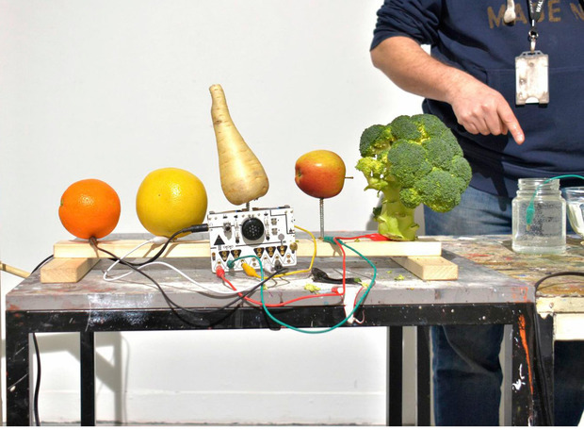
Karl Heinz Jeron | 2013
01
sonification
02
interface
Notes:
Within this, we think there are two ways to consider the approach: 1 – sonification (is related to turning into sound a flow of data, in this case, the electrical activity of the plant is transformed into sound.) and 2 – interface (, relates to the usage of plants to trigger sound, just like a keyboard.)
While we first were interested in using plants as an interface to perform, the more we read about plants, the more I consider it was sort of stupid to approach the plants as an interface. The reality is that plants are intelligent in their own way, they respond to stimulus, they communicate and much more. So, I abandoned the idea that the plant should be only reactive but instead could be helping and actively contributing to create and perform music.
O Cant(a)eiro vai buscar um pouco de cada uma destas abordagens

Slide 10
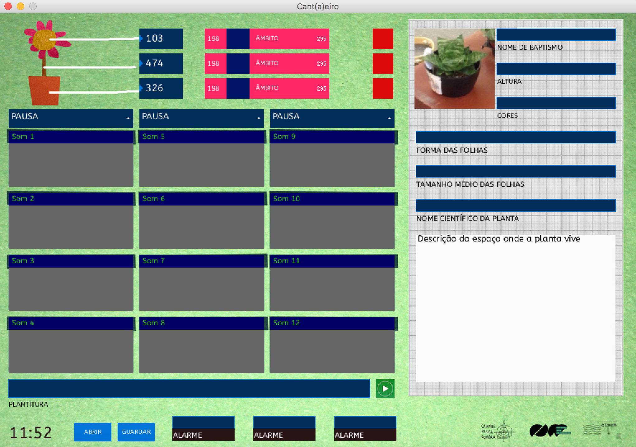
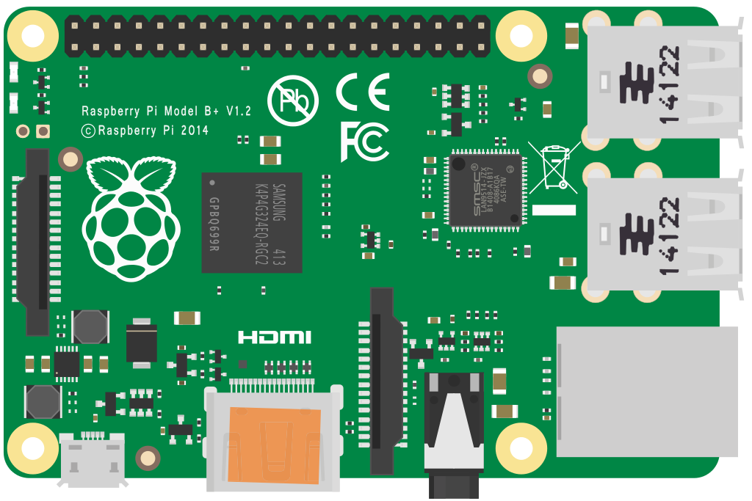
01 Galvanic
02 Light
Raspberry Pi
03 Moisture
Notes:
Since we are interested in getting this project in schools and because it is suppose to be affordable from schools, I am developing the hardware and the software to work with the Raspberry Pi.
I am interested to get the sensors to work with Scratch, to teach basic programming skills, but I am also developing a readymade software targeted to primary schools.

Slide 11
thanks flopes@ojm.pt ferreira@ese.ipp.pt

